Slide 1

Reflex Game
Chase the Doge
Antonio Copete - Daniella Álamo - Adrián Sánchez

Slide 2


WELCOME!

Slide 3
Some Learned Lessons
How to write HTML using JavaScript instead of using a static HTML with classes to show or hidden content.
Set the name of the documents and functions we want to use since the beginning of the project to avoid possible errors and duplicities. Everyone does “git pull” after and work around that base.
Get experience working with git, trying to respect and not touch the work of other colleagues. Also let the “Project Leader” to be the only one who touch the main branch and do the merges.
Make a custom minigame with JavaScript, HTML and CSS.

Slide 4
Organization

Slide 5
Organization
We decided to use Git to upload the changes of each one to a remote repository each in its branch.
For the organization of this project we use the Kanban GitHub tool and we distribute the tasks.
We always stayed in contact in a call and sharing the screen by Microsoft Teams. to communicate and show changes.

Slide 6
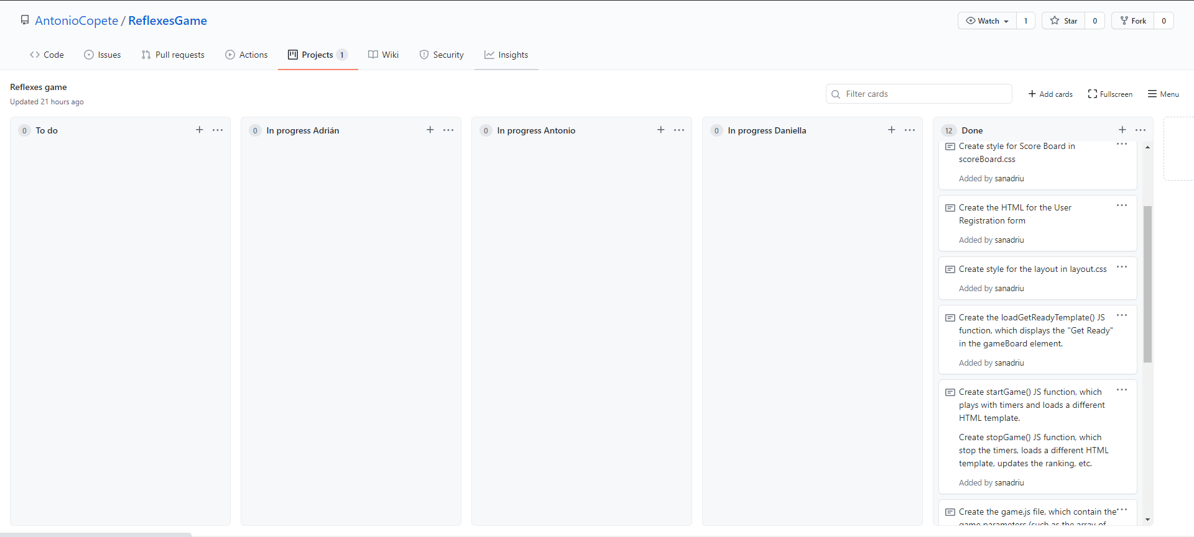
Organization
At the beginning of the project, we tried to identify the tasked that were going to be necessary to develop the project. We created tasks for JS functions that injects HTML templates, for CSS stylesheets related with a specific HTML template, for JS functions related with the functionality of the game and its interactivity, and so on.

Slide 7
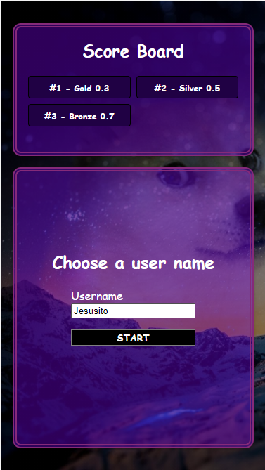
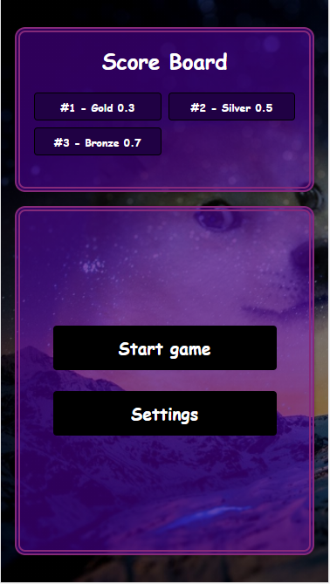
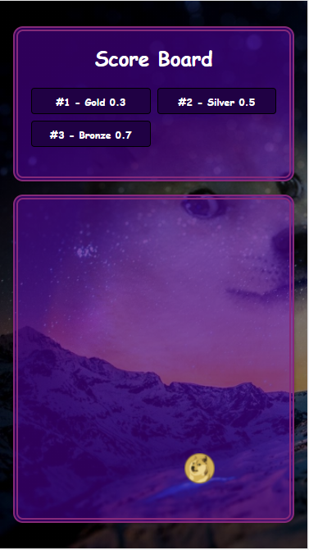
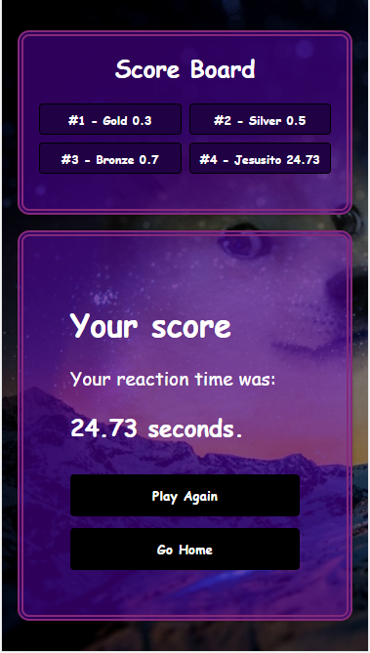
The game

Slide 8

THANKS!
And play our game pls :D
https://github.com/AntonioCopete/ReflexesGame

